Slide 1
Next.JS
Lecture 29
Starting Next

Slide 2
Next.JS
Next.js is a flexible React framework that gives you building blocks to create fast web applications.
Next.js is an open-source web development framework created by Vercel enabling React-based web applications with
An intuitive page-based routing system (with support for dynamic routes)
Pre-rendering, both static generation (SSG) and server-side rendering (SSR) are supported on a per-page basis
Automatic code splitting for faster page loads
Client-side routing with optimized prefetching
Built-in CSS and Sass support, and support for any CSS-in-JS library
Development environment with Fast Refresh support
API routes to build API endpoints with Serverless Functions
Fully extendable

Slide 3
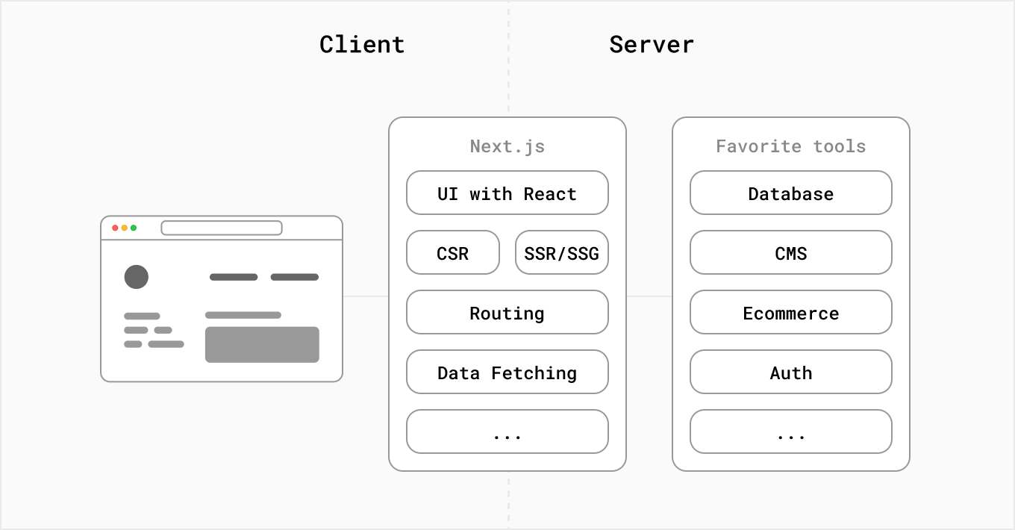
Next.JS

Slide 4
Development and Production Environments
Next.js provides features for both the development and production stages of an application.
In the development stage, It optimizes for the developer and their experience building the application.
It comes with features such the TypeScript and ESLint integration, Fast Refresh, and more.
In the production stage, Next.js optimizes for the end-users, and their experience using the application.
It aims to transform the code to make it performant and accessible.

Slide 5
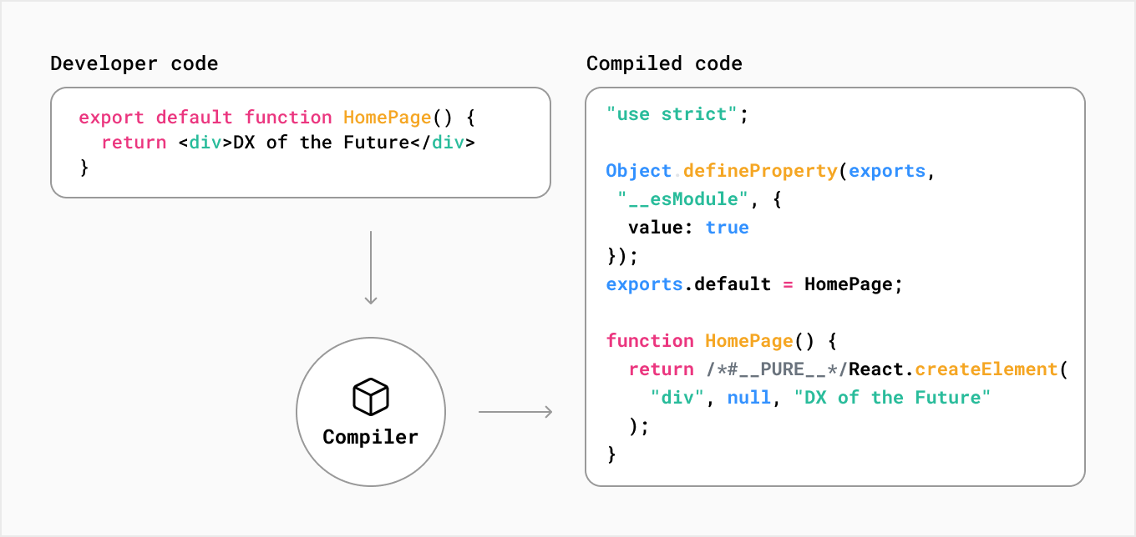
Compiling
In Next.js, compilation happens during the development stage as you edit your code, and as part of the build step to prepare your application for production.

Slide 6
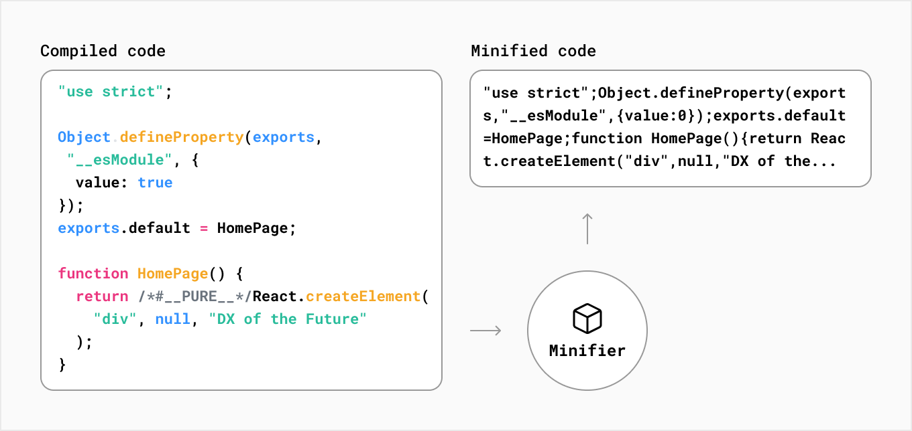
Minification
In Next.js, JavaScript and CSS files are automatically minified for production.

Slide 7
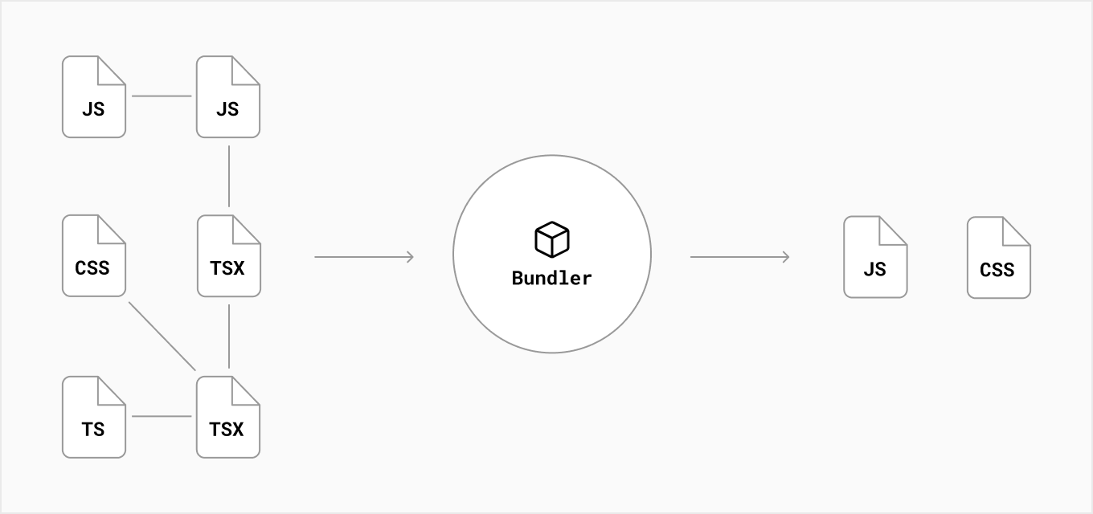
Bundling
Bundling is the process of resolving the web of dependencies and merging (or ‘packaging’) the files (or modules) into optimized bundles for the browser, with the goal of reducing the number of requests for files when a user visits a web page.

Slide 8
Code Splitting
Code-splitting is the process of splitting the application’s bundle into smaller chunks required by each entry point.
The goal is to improve the application's initial load time by only loading the code required to run that page.
Next.js has built-in support for code splitting. Each file inside your pages/ directory will be automatically code split into its own JavaScript bundle during the build step.
Any code shared between pages is also split into another bundle to avoid re-downloading the same code on further navigation.
After the initial page load, Next.js can start pre-loading the code of other pages users are likely to navigate to.
Dynamic imports are another way to manually split what code is initially loaded.

Slide 9
Build Time in next
Build Time
When you build your application, Next.js will transform your code into production-optimized files ready to be deployed to servers and consumed by users. These files include:
HTML files for statically generated pages
JavaScript code for rendering pages on the server
JavaScript code for making pages interactive on the client
CSS files

Slide 10
Rendering
With Next.js, three types of rendering methods are available: Server-Side Rendering, Static Site Generation, and Client-Side Rendering.
Pre-Rendering
Server-Side Rendering and Static Site Generation are also referred to as Pre-Rendering because the fetching of external data and transformation of React components into HTML happens before the result is sent to the client.

Slide 11
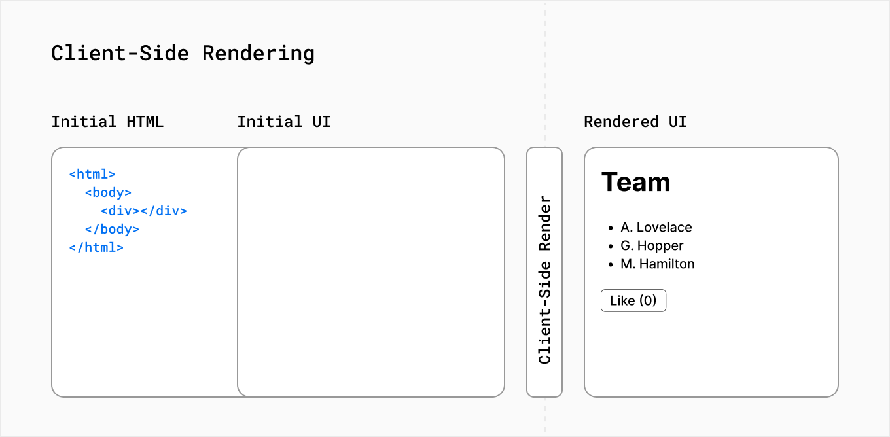
Client-Side Rendering vs. Pre-Rendering
In a standard React application, the browser receives an empty HTML shell from the server along with the JavaScript instructions to construct the UI. This is called client-side rendering because the initial rendering work happens on the user's device.

Slide 12
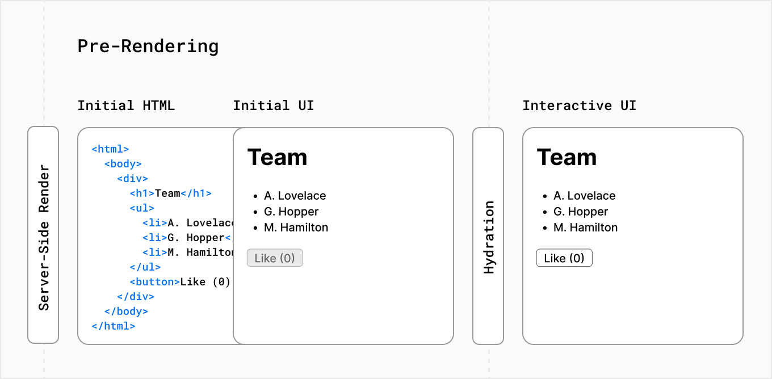
Pre-Rending in Next.JS
Next.js pre-renders every page by default. Pre-rendering means the HTML is generated in advance, on a server, instead of having it all done by JavaScript on the user's device.

Slide 13
Server-Side Rendering
With server-side rendering, the HTML of the page is generated on a server for each request. The generated HTML, JSON data, and JavaScript instructions to make the page interactive are then sent to the client.
On the client, the HTML is used to show a fast non-interactive page, while React uses the JSON data and JavaScript instructions to make components interactive (for example, attaching event handlers to a button). This process is called hydration.
In Next.js, you can opt to server-side render pages by using getServerSideProps.

Slide 14
getServerSideProps
If you export a function called getServerSideProps (Server-Side Rendering) from a page, Next.js will pre-render this page on each request using the data returned by getServerSideProps.
export async function getServerSideProps(context) {
return {
props: {}, // will be passed to the page component as props
}
}

Slide 15
getServersideprop
getServerSideProps only runs on server-side and never runs on the browser. If a page uses getServerSideProps, then:
When you request this page directly, getServerSideProps runs at request time, and this page will be pre-rendered with the returned props
When you request this page on client-side page transitions through next/link or next/router, Next.js sends an API request to the server, which runs getServerSideProps
getServerSideProps returns JSON which will be used to render the page. All this work will be handled automatically by Next.js, so you don’t need to do anything extra as long as you have getServerSideProps defined.

Slide 16
Static Site Generation
With Static Site Generation, the HTML is generated on the server, but unlike server-side rendering, there is no server at runtime. Instead, content is generated once, at build time, when the application is deployed, and the HTML is stored in a CDN and re-used for each request.
In Next.js, you can opt to statically generate pages by using getStaticProps.

Slide 17
getStaticProps
If you export a function called getStaticProps (Static Site Generation) from a page, Next.js will pre-render this page at build time using the props returned by getStaticProps.
export async function getStaticProps(context) {
return {
props: {}, // will be passed to the page component as props
}
}
You should use getStaticProps if:
The data required to render the page is available at build time ahead of a user’s request
The data comes from a headless CMS
The page must be pre-rendered (for SEO) and be very fast — getStaticProps generates HTML and JSON files, both of which can be cached by a CDN for performance
The data can be publicly cached (not user-specific). This condition can be bypassed in certain specific situation by using a Middleware to rewrite the path.

Slide 18
The beauty of Next.js is that you can choose the most appropriate rendering method for your use case on a page-by-page basis, whether that's Static Site Generation, Server-side Rendering, or Client-Side Rendering.

Slide 19
Pages
In Next.js, a page is a React Component exported from a .js, .jsx, .ts, or .tsx file in the pages directory. Each page is associated with a route based on its file name.
export default function About() {
return <div>About</div>
}

Slide 20
Pages with Dynamic Routing
Next.js supports pages with dynamic routes. For example, if you create a file called pages/posts/[id].js, then it will be accessible at posts/1, posts/2, etc.
import { useRouter } from 'next/router'
const Post = () => {
const router = useRouter()
const { pid } = router.query
return <p>Post: {pid}</p>
}
export default Post

Slide 21
API Routes
API routes provide a solution to build your API with Next.js.
Any file inside the folder pages/api is mapped to /api/* and will be treated as an API endpoint instead of a page. They are server-side only bundles and won't increase your client-side bundle size.
For example, the following API route pages/api/user.js returns a json response with a status code of 200:
export default function handler(req, res) {
res.status(200).json({ name: 'John Doe' })
}

Slide 22
Starting Next.JS
npx create-next-app@latest nextjs-blog
Using sample site
npx create-next-app@latest nextjs-blog --use-npm --example https://github.com/vercel/next-learn/tree/master/basics/learn-starter
cd nextjs-blog
Npm run dev
Will be started at
http://localhost:3000

Slide 23
Lazy loading
Lazy loading is a concept that we can use to reduce the initial load time of a particular page in web applications.
By using lazy loading we render content on demand of the user, so when the user scrolls down we load the content gradually, not during the initial rendering of the page.

Slide 24
Lazy loading
import Child1 from "../Child1"; import Child2 from "../Child2"; import Child4 from "../Child4"; import Child5 from "../Child5"; import useOnScreen from "../useOnScreen"; const Child3 = dynamic(() => import("../Child3"));const ParentComponent = () => { const child3Ref = useRef(); const child3RefValue = useOnScreen(child3Ref); const [isChild3Ref, setIsChild3Ref] = useState(false);useEffect(() => { if (!isChild3Ref) setIsChild3Ref(child3RefValue); }, [child3RefValue])return <div> <Child1/> <Child2/> <div ref={child3Ref}> {isChild3Ref && <Child3/>} </div> <Child4/> <Child5/> </div>}

Slide 25
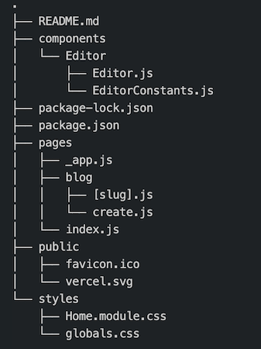
Application structure

Slide 26
Managed Next.js with Vercel
Vercel is the fastest way to deploy your Next.js application with zero configuration.
When deploying to Vercel, the platform automatically detects Next.js, runs next build, and optimizes the build output for you, including:
Persisting cached assets across deployments if unchanged
Immutable deployments with a unique URL for every commit
Pages are automatically statically optimized, if possible
Assets (JavaScript, CSS, images, fonts) are compressed and served from a Global Edge Network
API Routes are automatically optimized as isolated Serverless Functions that can scale infinitely
Middleware are automatically optimized as Edge Functions that have zero cold starts and boot instantly

Slide 27
Other Features
AMP Support
With Next.js you can turn any React page into an AMP page, with minimal config, and without leaving React.
TypeSctipt support
Next.js provides an integrated TypeScript experience, including zero-configuration set up and built-in types for Pages, APIs, and more.
You can create a TypeScript project with create-next-app using the --ts, --typescript flag

